Slide 1


Git and GitHub
Version Control Systems
SoftUni Team
Technical Trainers
Software University
https://softuni.bg

Slide 2
Table of Contents
Software Configuration Management
Introduction to Git
Introduction to GitHub

Slide 3
Have a Question?
sli.do
#fund-common

Slide 4
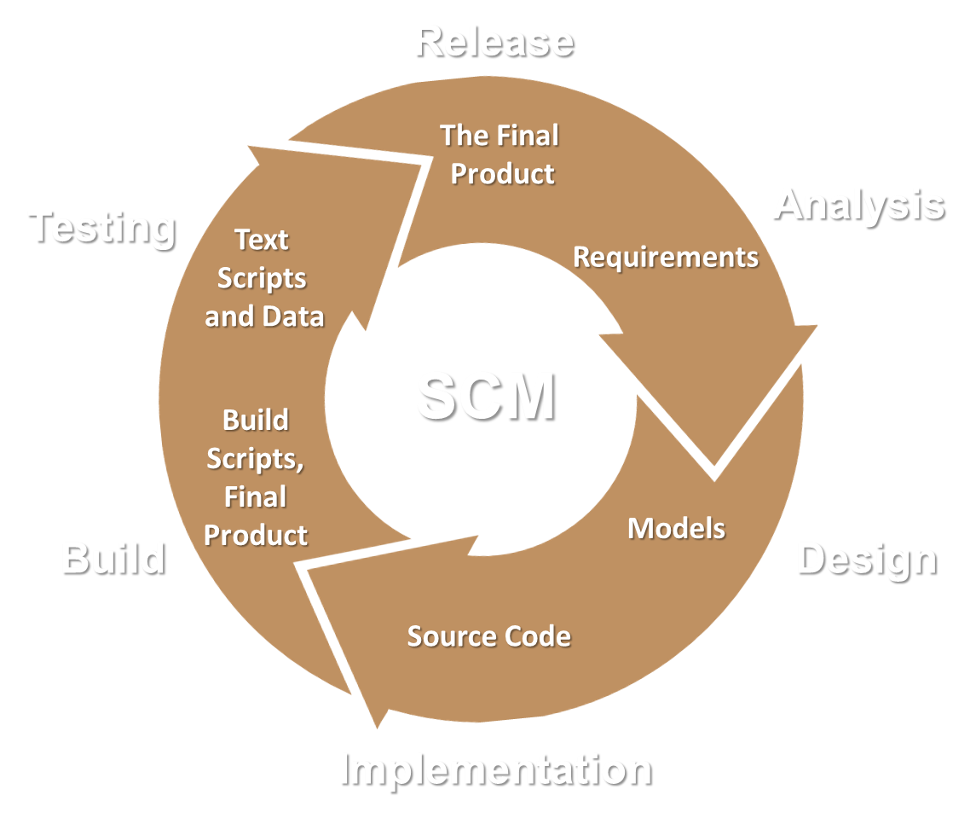
Software Configuration Management
Working on Shared Code and Project Assets

Slide 5
Software Configuration Management
Version Control ≈ Software Configuration Management (SCM)
A software engineering discipline
Consists of techniques, practices and tools for working on shared source code and files
Mechanisms for management, control and tracking the changes
Defines the process of change management
Keeps track of what is happening in the project over time
Solves conflicts in the changes

Slide 6
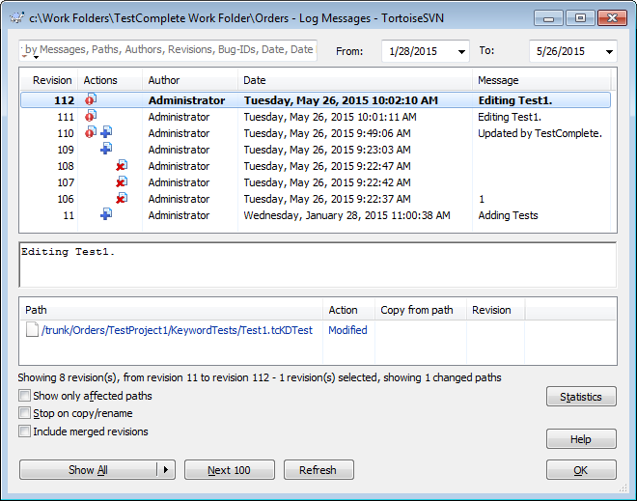
Change Log
Systems for version control keep their own change log (version history). It shows:
Who?
When?
Why?
What had been changed?
Old versions could be restored

Slide 7


Vocabulary: Repository (Repo)
Repo holds the project in a remote server
Remote
Local

Slide 8
Vocabulary: Clone
Clone == download a local copy of the remote project
Remote
Clone
Local

Slide 9

Vocabulary: Commit
Commit == saves the changes locally
Remote
Commit
Local

Slide 10


Vocabulary: Sync (Pull / Push)
Pull – take and merge the changes from the Remote
Push – send local changes to the Remote
Remote
Merge
Push
Pull
Local
Conflict

Slide 11
Vocabulary: Branch
master
master
custom-branch

Slide 12
Vocabulary: Merge Branches
Conflict
master
master
custom-branch

Slide 13





Example: Branches

Slide 14

Git
World's Most Popular Source Control System

Slide 15
What is Git?
Git == distributed source-control system
The most popular in the world
Free, open-source software
Works with local and remote repositories
Git bash – command line interface for Git
Runs on Linux, macOS and Windows (msysGit)
https://git-scm.com
https://www.atlassian.com/git/tutorials/setting-up-a-repository

Slide 16
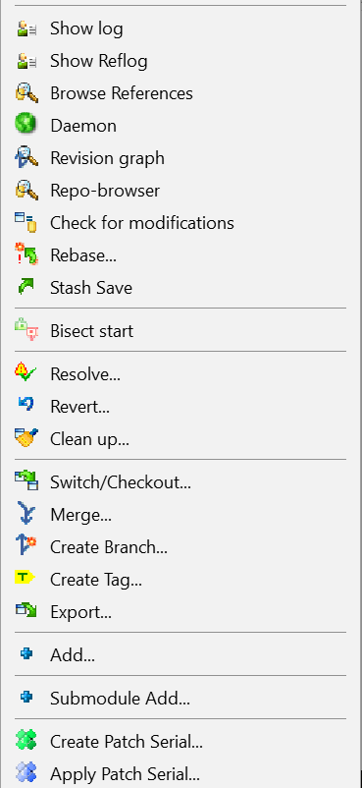
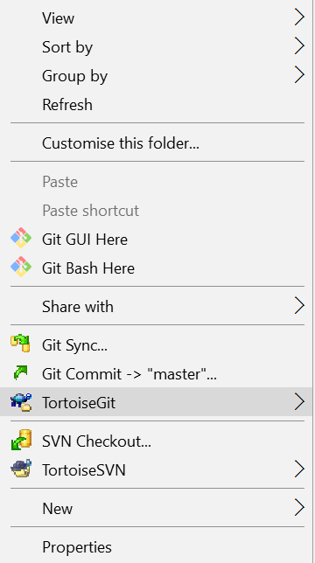
Using Git
Console-based Git client
git, GitBash
Windows GUI client – TortoiseGit
https://tortoisegit.org/download
Visual Studio / Eclipse plug-ins
GitHub Desktop client
https://desktop.github.com

Slide 17
Installing Git
MsysGit installation on Windows
https://git-scm.com/downloads
Options to Select (They Should Be Selected by Default)
"Use Git Bash Only"
"Checkout Windows-style, Commit Unix-style Endings"
Git installation on Linux:
sudo apt-get install git

Slide 18
Basic Git Commands (1)
Cloning an existing Git repository
Fetch and merge the latest changes from the remote repository
Preparing (adding / selecting) files for a commit
Committing to the local repository
git clone [remote url]
git pull
git add [filename] ("git add ." adds everything)
git commit –m "[your message here]"

Slide 19
Basic Git Commands (2)
Check the status of your local repository (see the local changes)
Creating a new local repository (in the current directory)
Creating a remote (assign a short name for remote Git URL)
Pushing to a remote (send changes to the remote repository)
git status
git init
git remote add [remote name] [remote url]
git push [remote name] [local name]

Slide 20

GitHub
The World's #1 Developer Collaboration Cloud

Slide 21
What is GitHub?
GitHub is the world's #1 source code hosting site
Free for open-source projects
Paid plans for private repositories
GitHub provides:
Git source code repository
Issue tracker (bug tracker)
Project board (Kanban style)
Wiki pages (documentation)
Build system (actions)
Site hosting (pages)
Discussions (forum)

Slide 22

Live Exercises
Creating a Repo, Cloning a Repo, Commit and Push Changes, Resolve Conflicts, Team Interactions

Slide 23

Summary
…
…
…
Use version control systems to work in a team
Keep the code in a central repository
Handle merge conflicts with ease
Important Git commands:
clone, add, commit, pull, push
GitHub == the world's most used software project hosting platform
Git repository, issue tracker, Kanban board, Wiki

Slide 24
Questions?
Notes:
24

Slide 25











SoftUni Diamond Partners

Slide 26



Educational Partners

Slide 27
Trainings @ Software University (SoftUni)
Software University – High-Quality Education, Profession and Job for Software Developers
softuni.bg
Software University Foundation
softuni.foundation
Software University @ Facebook
facebook.com/SoftwareUniversity
Software University Forums
forum.softuni.bg
Notes:
27

Slide 28

License
This course (slides, examples, demos, exercises, homework, documents, videos and other assets) is copyrighted content
Unauthorized copy, reproduction or use is illegal
© SoftUni – https://softuni.org
© Software University – https://softuni.bg
Notes:
28

